Slide 1





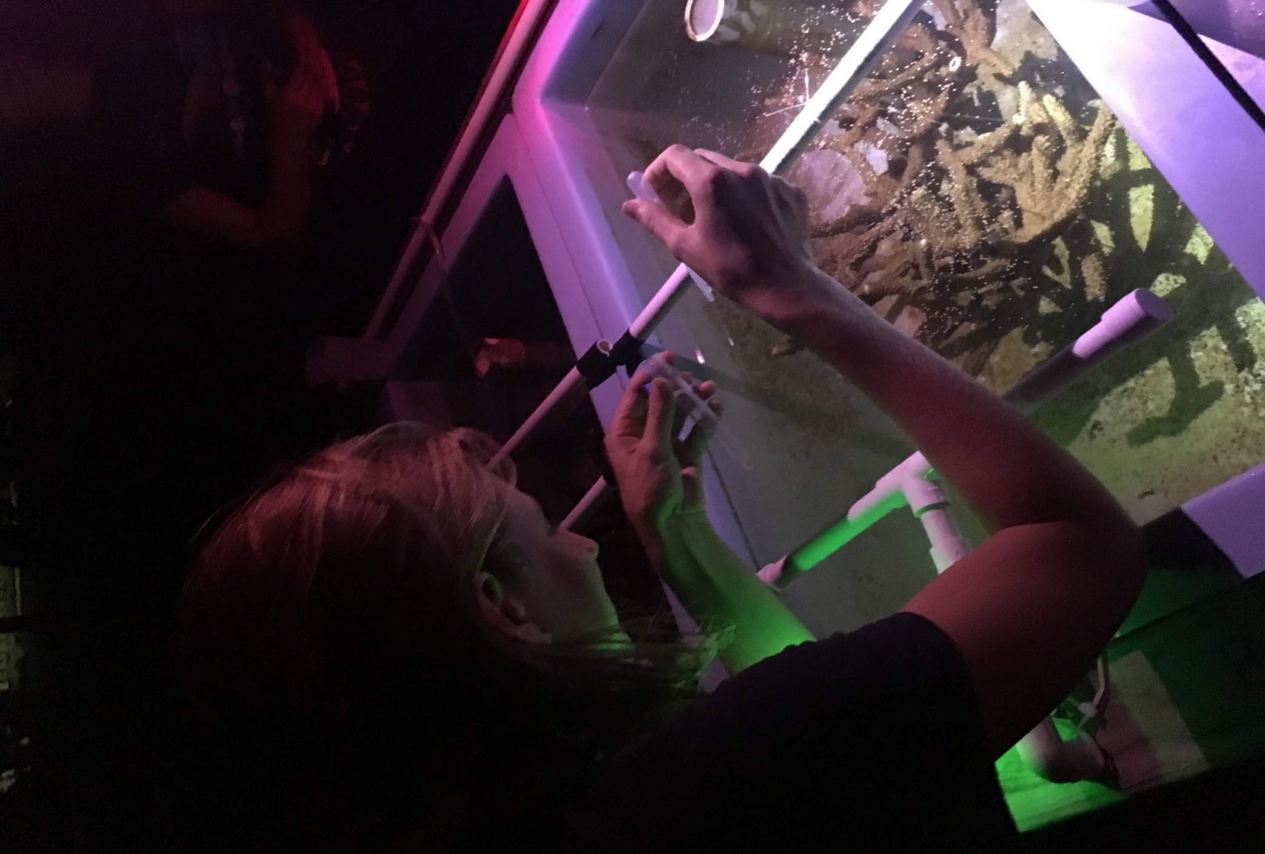
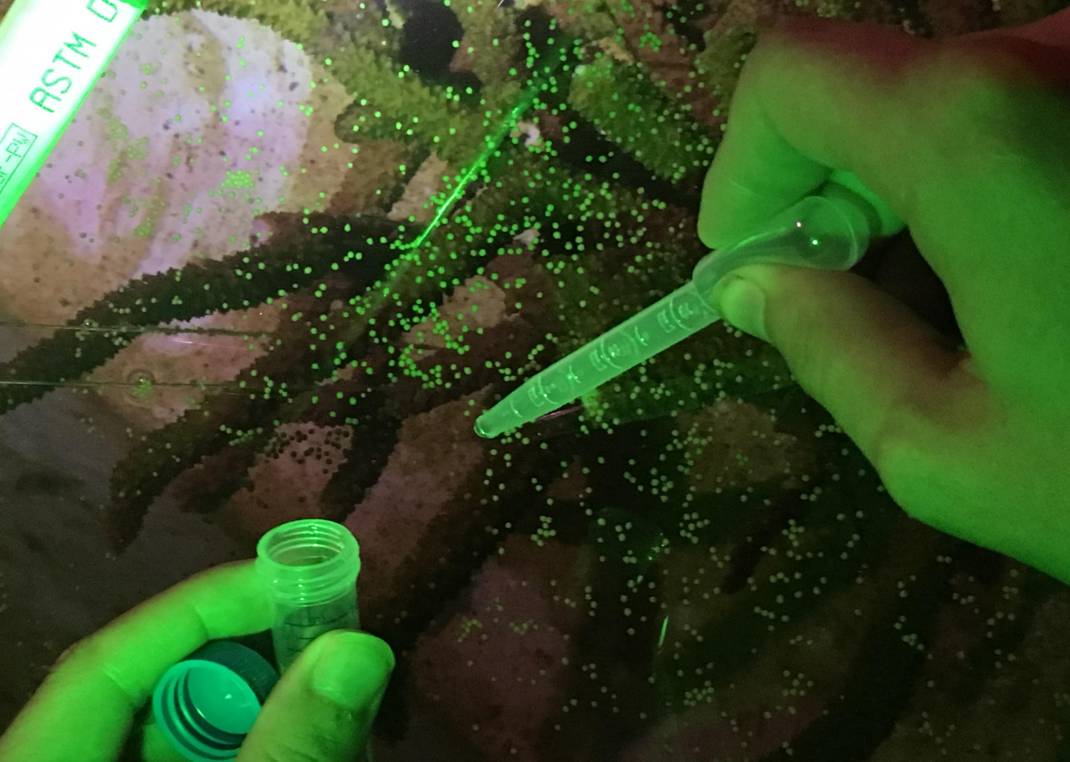
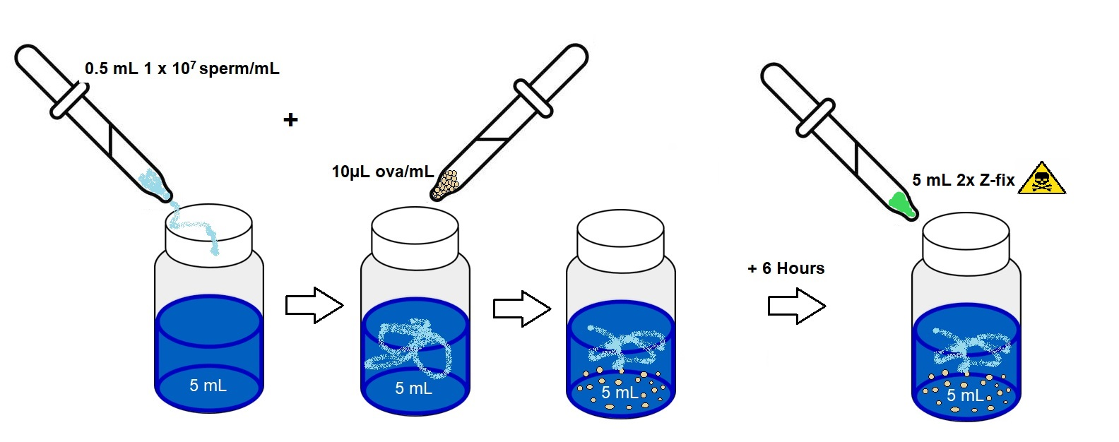
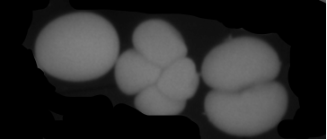
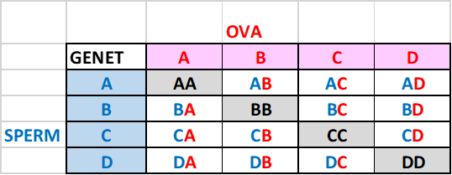
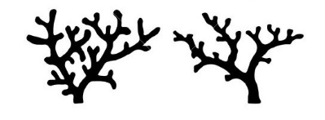
Observations of Fertilization Trends for Acropora cervicornis
Emily Parsons (GPMB, University of Charleston, SC)
Major Advisor: Dr. Cheryl M. Woodley
Abstract
Methods
4. Fertilization Counts
Acropora cervicornis (Staghorn coral) is an important reef building shallow-water stony coral species in the Florida Keys and Caribbean. Populations of these corals have declined to the point that they are listed as threatened under the U.S. Endangered Species Act. Though these declines have been attributed many stressors, the result is that these species are experiencing unsustainable reproductive failure and increasing susceptibility to disease. Most current restoration efforts to recover these species focus on asexual coral nursery propagation for out-planting that do not incorporate practices to enhance sexual reproductive outcomes that would aid in increasing genetic diversity. A. cervicornis is an annual broadcast spawner, introducing genetic diversity throughout their populations through sexual reproduction. For ESA-coral recovery efforts, assisted propagation is being piloted as a means of addressing sexual reproduction. This study investigates whether the genetic relatedness (i.e., distance) of the individual genotypes affects gamete compatibility and thus should be considered in coral restoration practices.
1. Sample Collection
2. Fertilization Assay
4. Fertilization Counts
A
B
A
B
C
Figure 2. Fertilization of ova was done by adding 0.5 mL of sperm diluted to 1 X 10^7 sperm/mL to 10uL of ova. Crosses were incubated at ambient (~27֯ C) temp for 6 hours. After incubation, samples were fixed with 5mL of 2x Z-fix solution to freeze cell division and preserve samples for imaging and fertilization counts.
Figure 4A. Example of 0% Fertilization (U50-U50)
Figure 4B. Example of ~50% Fertilization (U38-U94)
Figure 4C. Example of 100% Fertilization (B8-U38)
Fig. 1. Samples collected from individual A. cer genotypes at KML
3. Crossing Design
D
Figure 4D. Gauging fertilization: from left to right - unfertilized rounded ova, fertilized four-stage cell division, fertilized two-stage cell division, fertilized ‘cornflake’ stage.
Individual genotypes were brought from the Coral Reef Foundation’s field nurseries into the outdoor raceways at Keys Marine Lab. 1A. Bundles were taken from the surface of the water during the spawning event. 1B. Collection was done by placing 1mL of bundles into 8mL of artificial seawater. Bundles lysed after 1 hour and sperm and ova were separated.
Ova were imaged with a digital camera (SPOT imaging)
Triplicate samples were averaged for % fertilization
Figure 3. Crosses were performed with a diallel crossing design to test reciprocal fertilization success. Each cross was done in triplicate.
Results
Conclusions
What’s Next?
Data show there is variation between rates of fertilization for individual genotypes
For certain genotypes, sperm appears to be more viable than the ova, and vice versa
Some pairwise crosses performed better than the batch crosses, and in one interesting case the pairwise cross performed worse than the self cross
Complete fertilization counts for second species, Orbicella faveolata
Genetic analysis of parent tissues for A. cervicornis and O. faveolata to determine genetic relatedness
Compare genetic relatedness results to fertilization results between the genets
Hypothesis: Green genet crosses (>80%) = more distantly related genotypes. Red genet crosses (<50%) = very close genetic relatedness
Acknowledgements
Lisa May, MS, Dr. Cheryl M. Woodley, Athena Burnett, Dr. Anna Toline, Amelia Moura (CRF), and Dr. Cindy Lewis (KML)

